Slide 1
campus security authority (csa) training
Hagerstown Community College
Campus Police Department & BIT/Care Team
Spring 2021

Slide 2
Learning Objectives
Explain briefly the background of Clery Act.
Define campus security authority (CSA).
Explain the responsibilities of a CSA, including what does not fall under his or her realm of responsibilities.
Identify reportable crimes.
Explain how to report crimes committed on or adjacent to campus.
Identify resources available at Hagerstown Community College.

Slide 3
Background of clery act
In 1986, Jeanne Clery, a student at Lehigh University, was raped and murdered in her dorm room by another student.
There had been 38 violent crimes on Lehigh’s campus in three years before Jeanne’s murder.
At the time there was no guidelines for schools reporting crimes that occurred on campus.
The Clery family sued Lehigh University for what their daughter “did not know.”
The family launched a nationwide campaign to force colleges and universities to disclose their crime statistics.
In 1990, the Student Right-to-Know and Campus Security; Crime Awareness and Campus Security Act was signed into law.

Slide 4
Background of clery (continued)
In 1998, the name was changed to the Jeanne Clery Disclosure of Campus Security Policy and Campus Crime Statistics Act, known as The Clery Act.
The law enacted in her memory is intended to ensure that students and other campus community members are aware of campus crime so they can make informed decisions about their safety.
The Clery Act requires higher education institutions to report crime statistics to current and prospective students and employees.
The Clery Act was Amended in 1992, 1998, 2000, 2008 and 2013. Each Amendment enacted additional requirements to the Clery Act.

Slide 5
Purpose of the clery act
The purpose of the Clery Act is to:
Provide the campus community with timely, accurate and complete information about crime and the safety of campus so that they can make informed decisions to keep themselves safe.
Encourage the reporting and the collection of accurate data of campus crime statistics.
Provide prospective students, faculty, and staff, accurate crime data and an appropriate overview of the institution’s policies that pertain to safety and security concerns.

Slide 6
Requirements of the clery act
Requirements of the Clery Act are:
Publish an Annual Security Report (ASR) by Oct. 1st of each year.
Maintain a Daily Crime Log for public inspection.
Disclose crime statistics for campus, public property adjacent to campus and certain non-campus locations.
Issue timely warnings about crimes that pose a continuing threat to students and employees.
Create and Publish Emergency Notification polices and procedures.
Create and Publish other policies and procedures to address issues such as Sexual Assault.
Submit crime statistics to Department of Education (DOE).
Failure to comply can lead to fines issues by the Department of Education and can lead to loss of federal funding.

Slide 7
DOE FINES FOR NON-COMPLIANCE
Currently, the Department of Education fine for non-compliance is $57,317, per violation.
The Department is tasked with enforcing the Clery Act and conducts compliance reviews, usually resulting from an initiated complaint.
After the compliance review, the decision is made as to whether a fine should be issued.
The largest ever Clery Act fine of $2.4 million was given to Penn State University after the Jerry Sandusky child sexual abuse scandal.

Slide 8
How does clery act impact you?
Many Crimes and incidents, especially sexual assaults, are often times not reported to the Campus Police, but to staff members, coaches, instructors, or counselors/advisors they trust.
In an effort to address this, the Clery Act designated “Campus Security Authorities” (CSAs) to provide information and data on crime and incidents that occurred on campus or near the campus - That’s where you come in.
The intent of including non-law enforcement personnel in the role of CSA is to acknowledge that some community members and students in particular, may be hesitant about reporting incidents to other campus-affiliated individuals.

Slide 9
Who is a campus security authority?
The law defines four categories of Campus Security Authority:
A campus police or campus security department of an institution (HCC Campus Police & Security)
Any individual or individuals who have responsibility for campus security but who do not constitute a campus police department or a campus security department (e.g., an individual who is responsible for monitoring the entrance into the college property)
Any individual or organization specified in an institution’s statement of campus security policy as an individual or organization to which students and employees should report criminal offenses to.
“Officials with significant responsibility for student and campus activities” including, but not limited to student housing, student discipline and campus judicial proceedings.
That’s you! ☺
CSAs are defined by function not by title:
Significant responsibility for student and campus activities
Regular contact with students

Slide 10
HCC examples of a campus security authority as defined in the past
HCC Campus Police and Security (includes Student Patrol workers)
Title IX Coordinator
Executive Director of Human Resources
Dean of Student Affairs
Director of Athletics and ARCC

Slide 11
Examples of CSA’s now
College Athletic Coaches
Athletic Trainer
Faculty Advisor to a student group
Title IX Coordinator
BIT/Care team members
Victim Advocate
Staff member in charge of student activities on campus

Slide 12
Campus security authorities responsibilities
What to Do -
Always report a crime, even if you are in doubt of whether it is a “Clery” Crime in a Clery geographical location (on campus or satellite location)
Always report an incident to Campus Police, even if you believe to be insignificant.
If you have a question, talk to your Campus Police officer, Director of Public Safety or Dean of Student Affairs.
When in doubt, (when a crime or significant incident is reported to you) report it immediately to HCC CAMPUS POLICE! 240-500-2308

Slide 13
Campus security authorities responsibilities (continued)
What NOT to do -
Do NOT keep an incident or crime to yourself.
Do NOT be a detective and follow up on the report.
Do NOT give advice on whether or not report the crime to law enforcement.
Do NOT try to apprehend the “alleged” perpetrator of a crime.
You will put yourself and the victim at risk!
You are seen as a agent of Hagerstown Community College and your actions will be considered actions of the college.

Slide 14
What do you report?
There is a mandatory reporting requirement for all Clery crimes that occur in the following geographical locations.
On campus – This includes the Main Campus, the Valley Mall Center, and the Commercial Truck Driving location.
On public property adjacent to campus (e.g.. Roads, thoroughfares, sidewalks)
On non-campus property owned or controlled by HCC or recognized student organization that is held off location.
LOCATION, LOCATION, LOCATION… Very Important.

Slide 15
Crimes that must be reported (4 general categories of crime)
1. Criminal Offenses
Criminal homicide
Aggravated assault
Sex offenses (rape, fondling, statutory rape and incest)
Robbery
Burglary
Motor Vehicle Theft
Arson
2. Hate Crimes
3. Liquor, Drug, and Weapon Law violations
4. VAWA Offenses: Domestic Violence, Dating violence, and stalking.

Slide 16
Defining crimes
Criminal Homicide- murder, non- negligent manslaughter: the willful (non-negligent) killing od one human by another.
Negligent Manslaughter- The Killing of another person through gross negligence.
Aggravated Assault- unlawful attack upon another with intent to inflict severe injury, using a weapon or means likely to produce death or great bodily harm.
Burglary- unlawful entry into structure to commit a felony or theft.
Robbery- the taking or attempting to take anything of value from the care, custody, or control of a person or persons by force or threat of force or violence and/or by putting the victim in fear.
Motor Vehicle Theft- theft of automobiles, trucks etc.. Including “joyriding” (taking by person without lawful access).
Arson- willful or malicious burning/attempt to burn a structure, vehicle, or personal property of another.

Slide 17
Defining the crimes (continued)
Sex Offenses (Rape, Fondling, Incest, Statutory Rape)
Rape:
The penetration, no matter how slight, of the vagina or anus with any body part or object, or oral penetration by a sex organ of another person, without the consent of the victim
Incest:
Sexual intercourse between persons who are related to each other within the degrees wherein marriage is prohibited by law.
Fondling:
The touching of private body parts of another person for the purpose of sexual gratification, without the consent of the victim, including instances where, the victim is incapable of giving consent because of his/her age or because of his/her temporary mental or physical incapacity.
Statutory Rape:
Sexual Intercourse with a person who is under the statutory age of consent.

Slide 18
Defining the crimes (continued)
VAWA Offenses
VAWA Refers to Violence Against Women Act that amended the Clery Act in 2013 to expand reporting.
Dating Offenses:
Violence committed by a person who is or has been in a social relationship of a romantic or intimate nature with the victim. Dating violence includes, but is not limited to, sexual or physical abuse or the threat of such abuse.
Stalking:
Engaging in a course of conduct directed at a specific person that cause a reasonable person to:
Fear for the person’s safety or the safety of others; or suffer substantial emotional distress.
Course of Conduct:
Two or more acts including, but not limited to, acts in which the stalker directly, indirectly, or through third parties, by any action, method, device, or means, follows, monitors, observes, surveils, threatens, or communicates to or about a person, or interferes with a person’s property.

Slide 19
Defining the crimes (continued)
Domestic Violence- a felony or misdemeanor crime of violence committed by:
A current or former spouse or intimate partner of the victim;
A person with whom the victim shares a child in common;
A person who is cohabitating with, or has cohabitated with, the victim as a spouse or intimate partner;
A person similarly situated to a spouse of the victim under the domestic or family violence laws of the jurisdiction in which the crime of violence occurred.;
Any other person against an adult or youth victim who is protected from that person’s acts under the domestic or family violence laws of the jurisdiction in which the crime of violence occurred.

Slide 20
Hate crimes
Hate Crimes
A hate crime is a criminal offense committed against a person or property which is motivated, in whole or in part, by the offender’s bias. Bias is a preformed negative opinion or attitude toward a group of persons based on their race, gender, religion, disability, sexual orientation or ethnicity/national origin.
Although there are many possible categories of bias, under Clery, only the following six categories are reported:
• Race. A preformed negative attitude toward a group of persons who possess common physical characteristics (e.g., color of skin, eyes, and/or hair; facial features, etc.) genetically transmitted by descent and heredity, which distinguish them as a distinct division of humankind (e.g., Asians, blacks, whites).
• Gender. A preformed negative opinion or attitude toward a group of persons because those persons are male or female.
• Religion. A preformed negative opinion or attitude toward a group of persons who share the same religious beliefs regarding the origin and purpose of the universe and the existence or nonexistence of a supreme being (e.g., Catholics, Jews, Protestants, atheists).
• Sexual orientation. A preformed negative opinion or attitude toward a group of persons based on their sexual attraction toward, and responsiveness to, members of their own sex or members of the opposite sex (e.g., gays, lesbians, heterosexuals).
• Ethnicity/national origin. A preformed negative opinion or attitude toward a group of persons of the same race or national origin who share common or similar traits, languages, customs and traditions (e.g., Arabs, Hispanics).
• Disability. A preformed negative opinion or attitude toward a group of persons based on their physical or mental impairments/challenges, whether such disability is temporary or permanent, congenital or acquired by heredity, accident, injury, advanced age or illness.

Slide 21
Importance of reporting in a timely manner
Hagerstown Community College is required to notify the College community as soon as possible of any crime that may pose an ongoing or immeditate threat to the community (“Timely Warning”)
Investigation is easier when it immediately follows the reporting of a crime.
As a Campus Security Authority, you MUST NOT delay in reporting an incident that is reported to you.
Always make sure you document when the crime occurred and when it was reported to you.
TIMING IS CRITICAL

Slide 22
WHAT DO YOU WHEN SOMEONE REPORTS A CRIME TO YOU?
Ask the right questions:
Is the violent crime in progress? (if so, call the police immediately at 911. Then call HCC Campus Police 240-500-2308.
Has the victim sought or is the victim in need of assistance/services?
What happened? How, When, and Where did it happen? Is there an identified suspect?
The “WHEN” is very important. The law requires that the crime be reported for the calendar year in which it was the first reported to a CSA, not when it occurred, and not when it was reported to Campus Police by a CSA.
Has the incident been reported to Campus Police or to another Campus Security Authority?
Does the victim whish to remain anonymous?

Slide 23
WHAT DO YOU DO WHEN SOMEONE REPORTS A CRIME TO YOU? (continued)
Report the facts:
Campus Police will document the incident in a formal report. Your job is to get the information the person is willing to tell you.
Let the person know about options for reporting to Campus Police or a Security Officer.
A person who talks to you may not want to talk to Campus Police or Security if they don’t have to.
Offer referrals to campus and other resources, including:
Dean of Student Affairs
HCC BIT/Care Team
Community based resources Community Resource Book

Slide 24
What is not required to be reported
A crime that DID NOT occur on campus, or did not occur on a college-operated off-campus location or college sponsored event.
A crime that occurred before the student came to Hagerstown community college.
An incident that the CSA learned about through rumor or hearsay.
Even if the crime is not a required/reportable Clery crime, or it did not occur on campus or a Clery geographic location, you should encourage the student to reach out to the Dean of Student Affairs or file a Student Assistance Form Student Assistance Form if he/she needs help dealing with what occurred.

Slide 25
Reporting a crime or emergency
If a life-threatening emergency is taking place, call 911 first, then call the HCC Campus Police.
Dial 2308 from any campus phone or 240-500-2308 to reach a Campus Police Officer or Security Officer on duty.
All off-campus locations should call 911 and then notify the appropriate College administrator.
Red Emergency Phones are located in the buildings on the main campus. These phones call directly to Campus Police. If you are in a building and do not have cellphone service, these phones provide a direct line to Campus Police/Security.

Slide 26
Clery act csa review
The Clery Act is a federal law with mandatory requirements for institutions of higher education.
The Clery Act requires that a crime should be reported if it occurred:
On campus
On Public Property adjacent to campus (e.g roads, sidewalks)
On non-campus property owned or controlled by HCC (Valley Mall location and Commercial Truck Driving Range) or at a location attended by a recognized student organization (HCC athletic event held at another school or when an HCC club goes on a field trip).
Having designated Campus Security Authorities (CSAs) is a means to satisfy that requirement.
Many crimes and incidents are not reported to Campus Police, but to staff members whom they trust.
The location of the crime or incident will determine whether a crime should be reported. LOCATION…LOCATION…LOCATION!

Slide 27
Clery act csa review (continued)
“Good Faith” means there is a reasonable basis for believing the information is not simply a rumor or hearsay.
The timeliness of reporting is critical in Hagerstown Community College fulfilling its obligations under the law and maintaining a safe campus.
If an individual indicates that they’ve already contacted the police, and you are 100% confident that this is the case, you do not need to document and report the allegations.
Overwise, when in doubt, document and report the crime to Campus Police.

Slide 28
Clery act csa review (continued)
It is mandatory to report crimes that have occurred in the 4 classifications of Clery Crimes, which may have occurred within the clery geographic location:
Criminal offenses
Hate offenses
Arrest and Referrals of Liquor, Drugs and Weapons Law violations.
Domestic and Dating Violence, Stalking
Report the crime
Provide the facts and be as detailed as possible in your report.
Listen to the individual reporting the crime and provide resources to the individual for additional help and support.

Slide 29
Scenario
You are a coach at HCC and a student athlete tells you about an incident that occurred last year. This student tells you another student, on the women’s soccer team, was sexually assaulted by her ex-boyfriend after a game. This student does not know all the details, but believed it happened in the parking lot behind the ARCC. The student tells you the person’s first name and said she believes the student is no longer attending classes at HCC. What do you do?
You would gather as much information from this person as possible and immediately forward that to the HCC Campus Police. Not a crime in progress, so no need to call 911.

Slide 30
Scenario
You are an advisor at HCC and you are meeting with a Middle College student. During your meeting, this student asks for information on counseling services. During your conversation, this student reveals that he is getting threatening text messages and had the windows on his car broken out last week. The student tells he believes he is being targeted because of his sexual orientation. This student also tells you he had the windows broken out on his car, while parked on the main campus. What do you do?
The threats and destruction of property are likely motivated by a bias to this student’s sexual orientation. You would report this crime immediately to the HCC Campus Police. This would be an incident that would also be documented by HCC Campus Police for the annual security report.

Slide 31
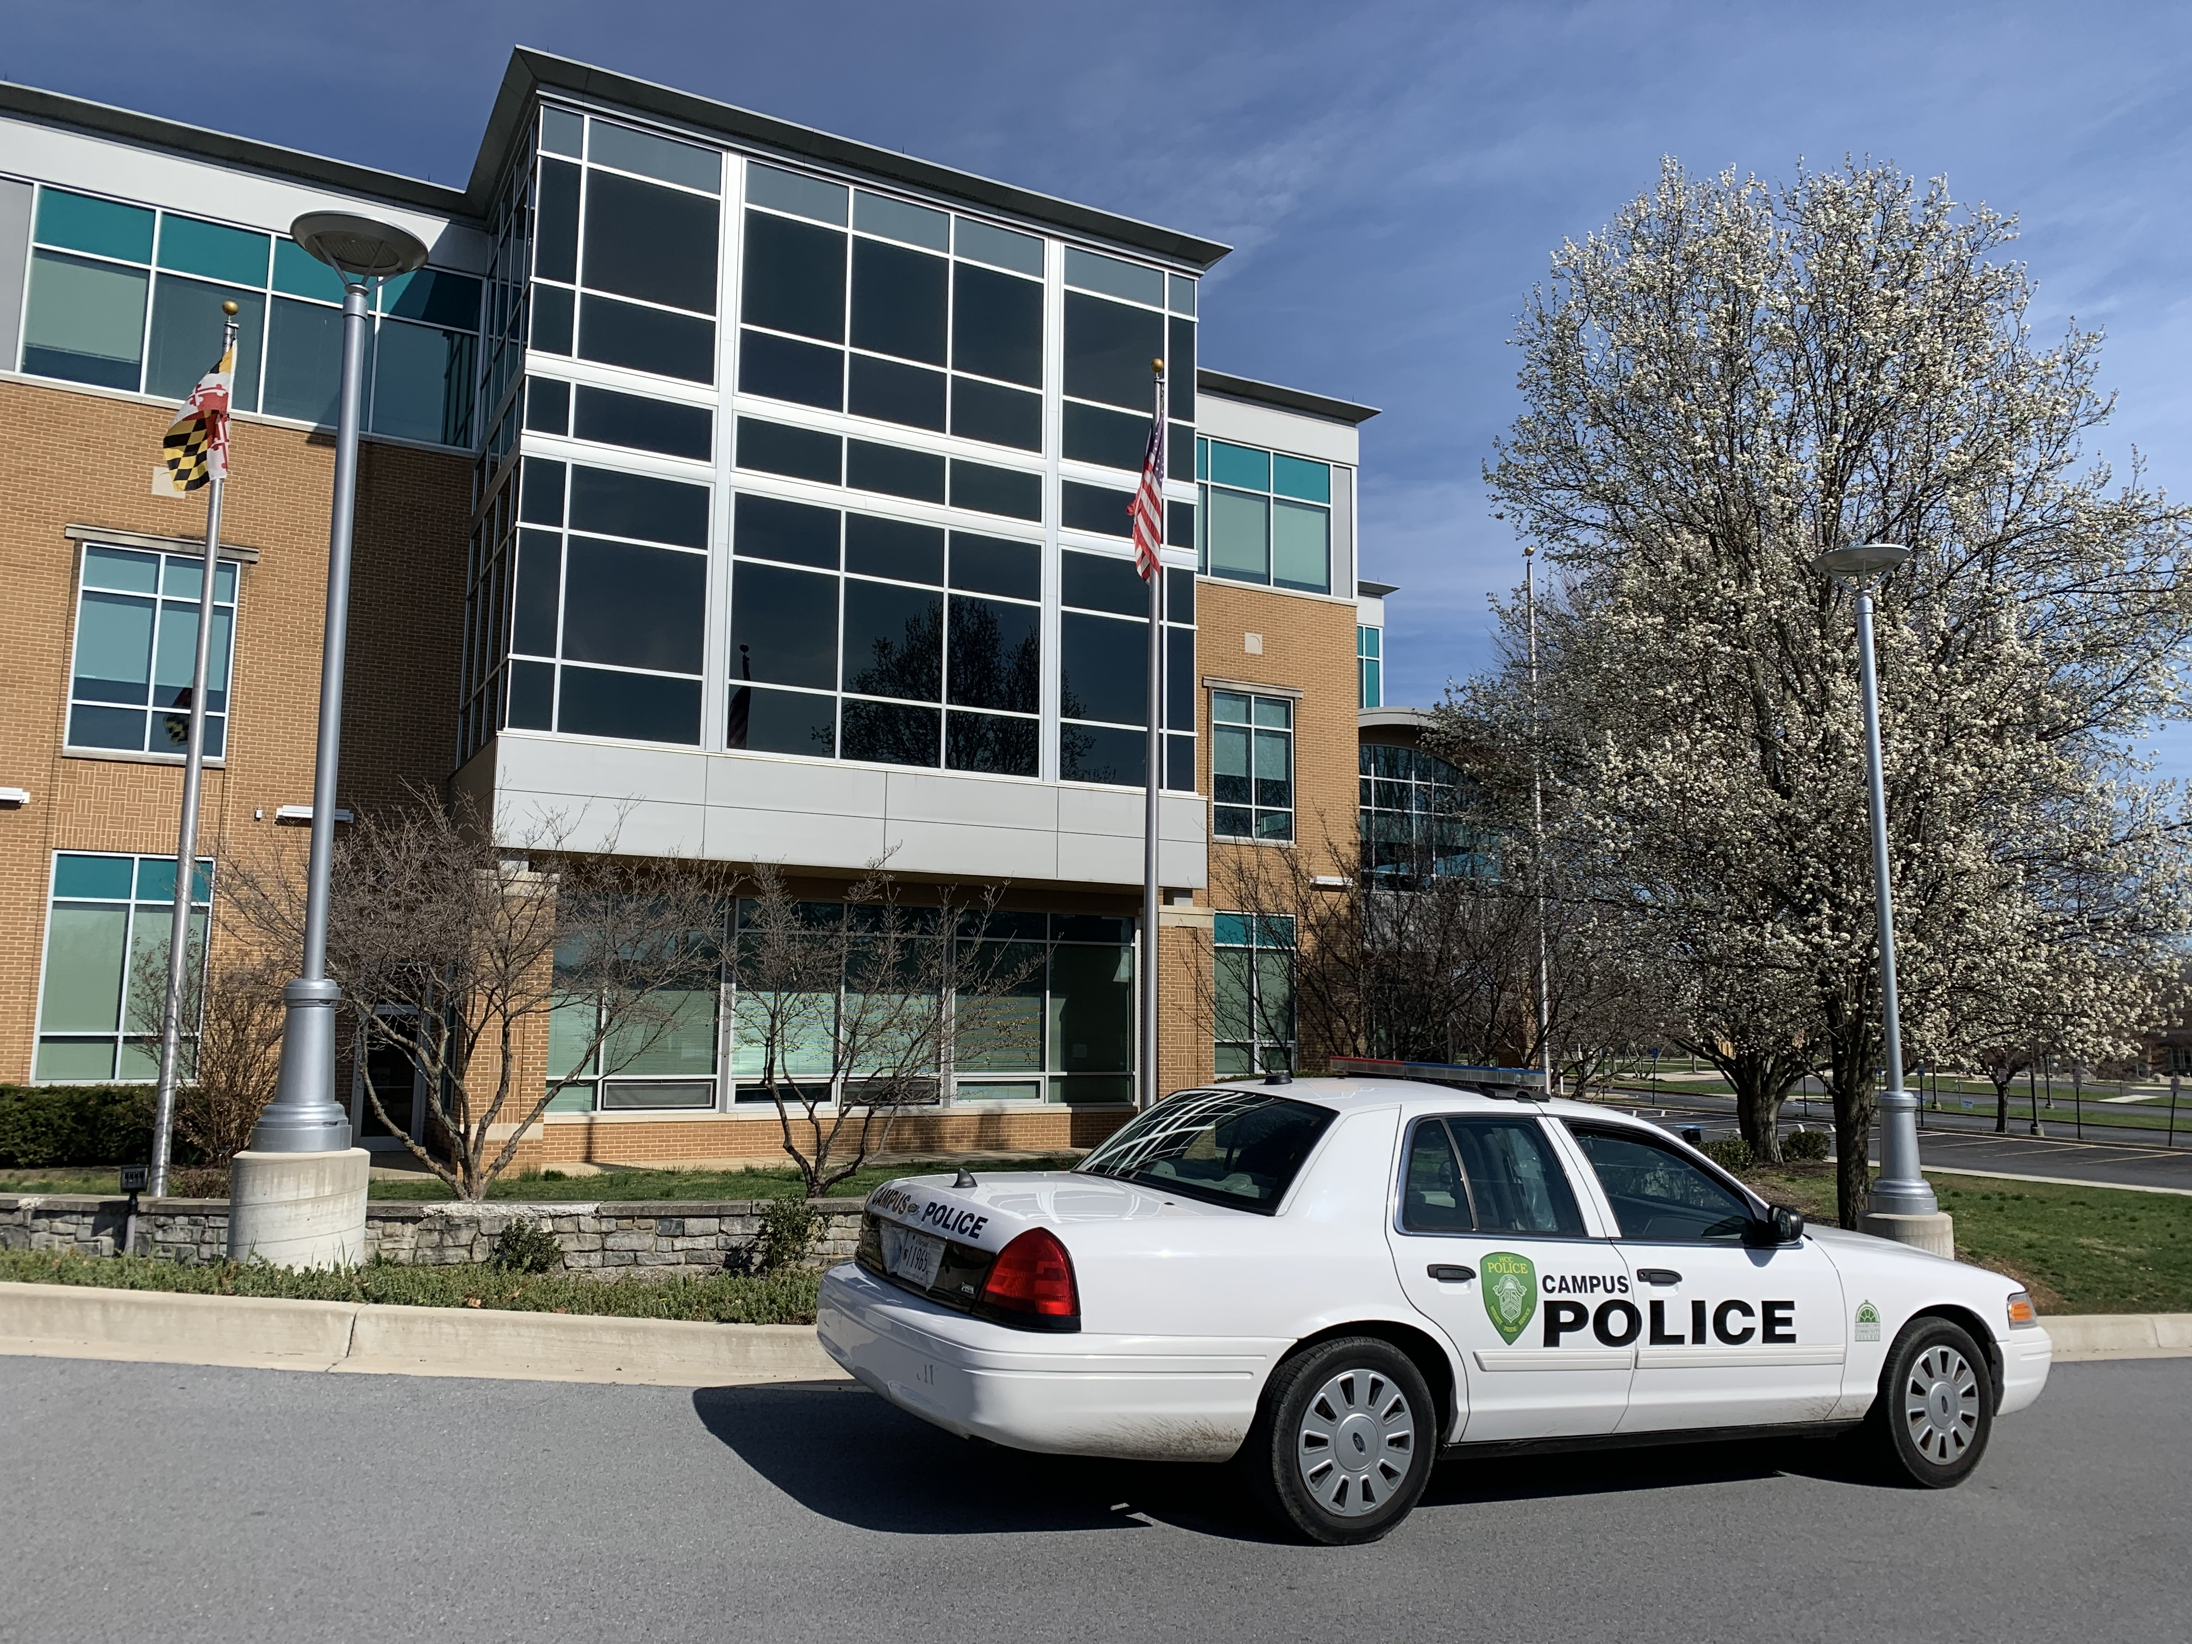
Need further information?
Questions or further information on Clery Act:
Contact the office of Campus Police at 240-500-2308 or 2334
Further information regarding campus safety and to read the Clery Annual Security Report (ASR)
http://www.hagerstowncc.edu/docs/campus-police-and-safety/campus-police-annual-security-report

Slide 32
HCC Campus Police & Security
Campus Police Officers
HCC Campus Security
Chief Eric Byers 240-500-2501/240-675-0619
Officer Tim Calimer 240-500-2203
Officer William Alemar 240-500-2312
Officer James Ondrish 240-500-2312
Hagerstown Community College Campus Police Officers are Certified Police Officers with the Maryland Police and Corrections Training Commission. HCC Campus Police can make criminal arrests and enforce traffic violations on the main campus of Hagerstown Community College
Security Officer Ryan Consoletti
Security Officer Curtis Chedester
240-500-2312

Slide 33
The Handbook for Campus Safety

